Slide 1



LumberChunker Long-Form Narrative Document Segmentation
André V. Duarte¹, João Marques¹, Miguel Graça¹,
Miguel Freire², Lei Li^{3 ,} Arlindo Oliveira¹
¹INESC-ID / Instituto Superior Técnico ²Neuralshift ³Carnegie Mellon University
Notes:
Hello everyone, my name is André and today I’m going to present our recent work entitled LumberChunker

Slide 2

Motivation
Did you know about this?
Query
Q: “What award did Barack Obama offered Chinese President Xi Jinping in 2015?”
ChatGPT
Final Answer
A: Barack Obama offered Chinese President Xi Jinping the John F. Kennedy Profile in Courage Award in 2015. This award honors public officials who have demonstrated political courage by acting on their convictions, often in the face of opposition. The gesture was part of a broader effort to highlight the importance of leadership and courage in political life.

Slide 3

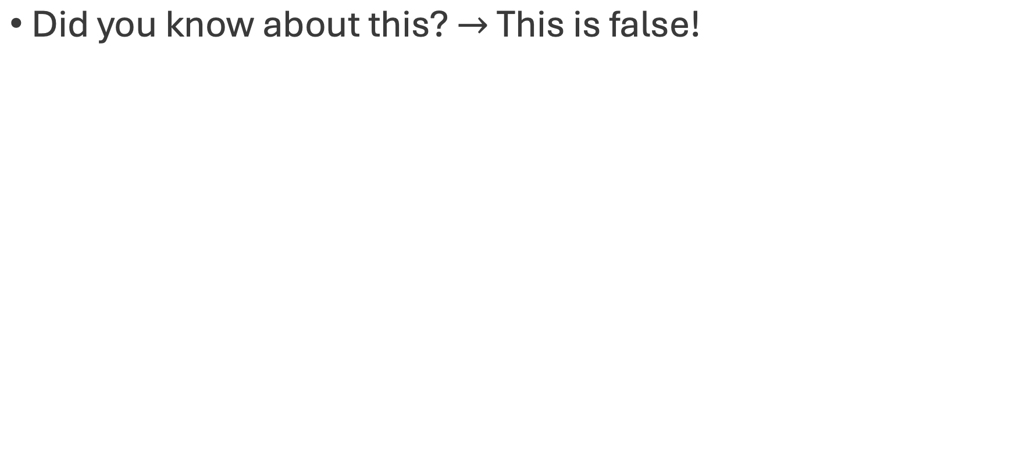
Motivation
Query
Q: “What award did Barack Obama offered Chinese President Xi Jinping in 2015?”
ChatGPT
Final Answer
A: Barack Obama offered Chinese President Xi Jinping the John F. Kennedy Profile in Courage Award in 2015. This award honors public officials who have demonstrated political courage by acting on their convictions, often in the face of opposition. The gesture was part of a broader effort to highlight the importance of leadership and courage in political life.

Slide 4
Motivation
Hallucinations are a problem in LLM-based Closed-Book QA.
Notes:
Hallucinations can be a big challenge when using large language models in an Closed-Book QA setting.

Slide 5
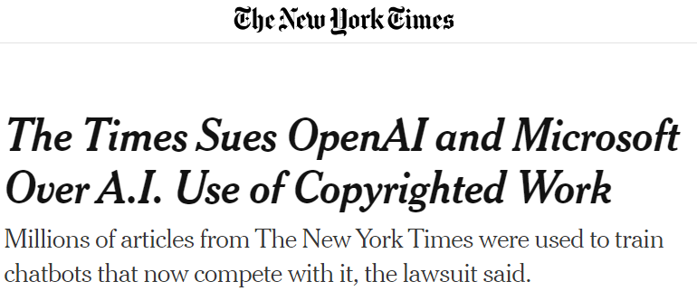

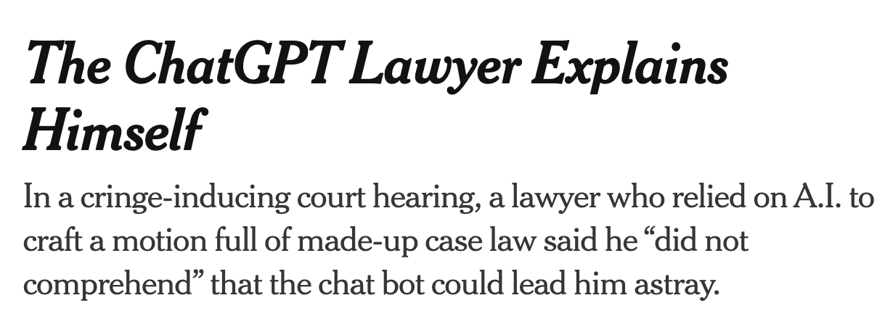
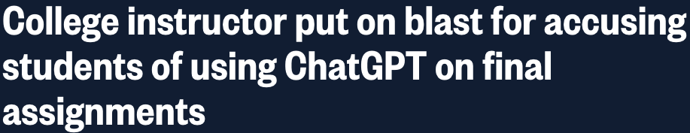
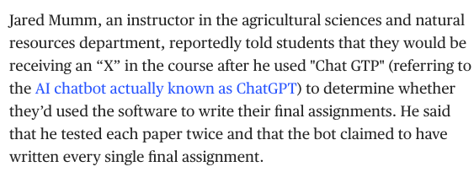

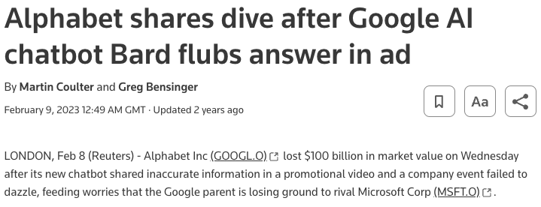
Motivation
Hallucinations are a problem in LLM-based Closed-Book QA.
The consequences can be serious!
Notes:
Hallucinations can be a big challenge when using large language models in an Open-Book QA setting.

Slide 6

Motivation
When factuality and precision are critical, a common approach is to give relevant information as context.
Query
Q: “What award did Barack Obama offered Chinese President Xi Jinping in 2015?”
Wikipedia Page
Profile in Courage Award
ChatGPT
Final Answer
A: Barack Obama, as President of the United States, did not offer any formal "award" to Chinese President Xi Jinping during his time in office. However, they engaged in significant diplomatic exchanges and state visits that included symbolic gestures of goodwill.
Notes:
Hallucinations can be a big challenge when using large language models in an Open-Book QA setting.

Slide 7

Motivation
What to do when context documents are really large?
Models have limited context length.
Query
Q: “When did Elon Musk live in Pennsylvania?”
Elon Musk
By Walter Isaacson Book
ChatGPT
A: The message you submitted was too long, please reload the conversation and submit something shorter.
Notes:
Hallucinations can be a big challenge when using large language models in an Open-Book QA setting.

Slide 8

Motivation
RAG grounds the answer generation on a set of contextually relevant documents.
Elon Musk
By Walter Isaacson Book
Query
Q: “When did Elon Musk live in Pennsylvania?”
Cosine-Similarity
0.81 | 0.42 | … | 0.89 | 0.73
ChatGPT
Final Answer
A: Elon Musk lived in Pennsylvania while attending the University of Pennsylvania from 1992 to 1997.
Notes:
That's where Retrieval-Augmented Generation, or RAG, comes in. By retrieving and incorporating relevant documents, RAG helps ensure that the answers are more grounded in context, reducing the likelihood of hallucinations.

Slide 9
Motivation
The way relevant documents are segmented is often over-looked.
Pride and Prejudice
Jane Austen
Chapter 1
It is a truth universally acknowledged, that a single man in possession of a good fortune must be in want of a wife.
However little known the feelings or views of such a man may be on his first entering a neighbourhood, this truth is so well fixed in the minds of the surrounding families, that he is considered as the rightful property of someone or other of their daughters.
“My dear Mr. Bennet,” said his lady to him one day, “have you heard that Netherfield Park is let at last?”
Mr. Bennet replied that he had not.
…
“It will be no use to us, if twenty such should come, since you will not visit them.”
“Depend upon it, my dear, that when there are twenty, I will visit them all.”
Mr. Bennet was so odd a mixture of quick parts, sarcastic humour,
reserve, and caprice, that the experience of three-and-twenty years had been insufficient to make his wife understand his character. Her mind was less difficult to develop. She was a woman of mean understanding, little information, and uncertain temper. When she was discontented, she fancied herself nervous. The business of her life was to get her daughters married: its solace was visiting and news.
Notes:
However, there’s one key aspect that’s often overlooked—the way these relevant documents are segmented.

Slide 10
Chunk this example!
ID1: “What about a story?” I said.
ID2: “Could you very sweetly tell Winnie-the-Pooh one?”
ID3: “I suppose I could,” I said. “What sort of stories does he like?”
ID4: “About himself. Because he’s that sort of Bear.”
ID5: “Oh, I see.”
ID6: “So could you very sweetly?”
ID7: “I’ll try,” I said.
ID8: So I tried.
ID9: Once upon a time, a very long time ago now, about last Friday, Winnie-the-Pooh lived in a forest all by himself under the name of Sanders.
ID10: ”What does ‘under the name’ mean?” asked Christopher Robin.
Winnie-the-Pooh
Notes:
Let me tell you a bit about the current approaches for performing text segmentation
And so, let’s consider an example, and look at this snippet from the Winnie-the-Pooh story. If you were performing manual segmentation of this text, how would you chunk it?

Slide 11
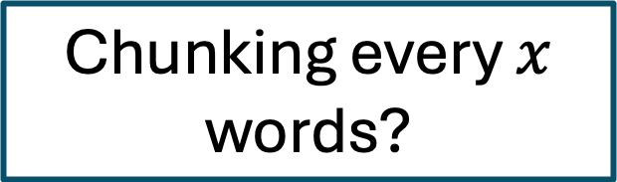
Chunk this example!
ID1: “What about a story?” I said.
ID2: “Could you very sweetly tell Winnie-the-Pooh one?”
ID3: “I suppose I could,” I said. “What sort of stories does he like?”
ID4: “About himself. Because he’s that sort of Bear.”
ID5: “Oh, I see.”
ID6: “So could you very sweetly?”
ID7: “I’ll try,” I said.
ID8: So I tried.
ID9: Once upon a time, a very long time ago now, about last Friday, Winnie-the-Pooh lived in a forest all by himself under the name of Sanders.
ID10: “What does ‘under the name’ mean?” asked Christopher Robin.
...
Winnie-the-Pooh
Notes:
Like this? Chunking every x number of words?

Slide 12

Chunk this example!
ID1: “What about a story?” I said.
ID2: “Could you very sweetly tell Winnie-the-Pooh one?”
ID3: “I suppose I could,” I said. “What sort of stories does he like?”
ID4: “About himself. Because he’s that sort of Bear.”
ID5: “Oh, I see.”
ID6: “So could you very sweetly?”
ID7: “I’ll try,” I said.
ID8: So I tried.
ID9: Once upon a time, a very long time ago now, about last Friday, Winnie-the-Pooh lived in a forest all by himself under the name of Sanders.
ID10: “What does ‘under the name’ mean?” asked Christopher Robin.
...
Winnie-the-Pooh
Notes:
Probably not!! right?? We can clearly see that most of the paragraphs are related and therefore, they should be grouped together.
This is the problem with classical approaches: they give such emphasis on keeping a good document structure that chunks can end up being quite random in terms of their content.

Slide 13
Chunk this example!
Recursive Chunking
Text is split by a list of characters: ["\n\n", "\n", " ", ""]
Ensuring chunks have a length similar to a predefined value.
Langchain's RecursiveCharacterTextSplitter.
Preserves sentence structure.
Completely disregards semantics.
Notes:
Probably not!! right?? We can clearly see that most of the paragraphs are related and therefore, they should be grouped together.
This is the problem with classical approaches: they give such emphasis on keeping a good document structure that chunks can end up being quite random in terms of their content.

Slide 14
Chunk this example!
ID1: “What about a story?” I said.
ID2: “Could you very sweetly tell Winnie-the-Pooh one?”
ID3: “I suppose I could,” I said. “What sort of stories does he like?”
ID4: “About himself. Because he’s that sort of Bear.”
ID5: “Oh, I see.”
ID6: “So could you very sweetly?”
ID7: “I’ll try,” I said.
ID8: So I tried.
ID9: Once upon a time, a very long time ago now, about last Friday, Winnie-the-Pooh lived in a forest all by himself under the name of Sanders.
ID10: ”What does ‘under the name’ mean?” asked Christopher Robin.
Winnie-the-Pooh
Notes:
If you were performing manual segmentation of this text, how would you chunk it?

Slide 15
Chunk this example!
ID1: “What about a story?” I said.
ID2: “Could you very sweetly tell Winnie-the-Pooh one?”
ID3: “I suppose I could,” I said. “What sort of stories does he like?”
ID4: “About himself. Because he’s that sort of Bear.”
ID5: “Oh, I see.”
ID6: “So could you very sweetly?”
ID7: “I’ll try,” I said.
ID8: So I tried.
ID9: Once upon a time, a very long time ago now, about last Friday, Winnie-the-Pooh lived in a forest all by himself under the name of Sanders.
ID10: ”What does ‘under the name’ mean?” asked Christopher Robin.
Winnie-the-Pooh
Notes:
So what if we chunked the text like this?

Slide 16
Chunk this example!
Christopher convinces narrator to tell story of Winnie-the-Pooh
ID1: “What about a story?” I said.
ID2: “Could you very sweetly tell Winnie-the-Pooh one?”
ID3: “I suppose I could,” I said. “What sort of stories does he like?”
ID4: “About himself. Because he’s that sort of Bear.”
ID5: “Oh, I see.”
ID6: “So could you very sweetly?”
ID7: “I’ll try,” I said.
ID8: So I tried.
ID9: Once upon a time, a very long time ago now, about last Friday, Winnie-the-Pooh lived in a forest all by himself under the name of Sanders.
ID10: ”What does ‘under the name’ mean?” asked Christopher Robin.
Winnie-the-Pooh
Notes:
In the first part we see that the narrator is checking what is the story that Christopher Robin would like to listen.

Slide 17
Chunk this example!
Christopher convinces narrator to tell story of Winnie-the-Pooh
ID1: “What about a story?” I said.
ID2: “Could you very sweetly tell Winnie-the-Pooh one?”
ID3: “I suppose I could,” I said. “What sort of stories does he like?”
ID4: “About himself. Because he’s that sort of Bear.”
ID5: “Oh, I see.”
ID6: “So could you very sweetly?”
ID7: “I’ll try,” I said.
ID8: So I tried.
ID9: Once upon a time, a very long time ago now, about last Friday, Winnie-the-Pooh lived in a forest all by himself under the name of Sanders.
ID10: ”What does ‘under the name’ mean?” asked Christopher Robin.
Winnie-the-Pooh
Story is starting
Notes:
And in the second part, we see that the story is finally starting.

Slide 18

Chunk this example!
Structure + Semantics
Christopher convinces narrator to tell story of Winnie-the-Pooh
ID1: “What about a story?” I said.
ID2: “Could you very sweetly tell Winnie-the-Pooh one?”
ID3: “I suppose I could,” I said. “What sort of stories does he like?”
ID4: “About himself. Because he’s that sort of Bear.”
ID5: “Oh, I see.”
ID6: “So could you very sweetly?”
ID7: “I’ll try,” I said.
ID8: So I tried.
ID9: Once upon a time, a very long time ago now, about last Friday, Winnie-the-Pooh lived in a forest all by himself under the name of Sanders.
ID10: ”What does ‘under the name’ mean?” asked Christopher Robin.
Winnie-the-Pooh
Story is starting
Notes:
So, now we have two perfectly separated chunks!
This makes way more sense right?
And our method aims to do exactly this. We want propose an approach that keeps both document structure while showing also good capability of understanding the semantic content of the text.

Slide 19
Requirements

Slide 20
Requirements
Chunks should be as independent as possible from one another.
We want chunks encapsulating entire ideas.
Notes:
Ideally, we want each chunk of content to be as independent as possible from one another.
Meaning chunks should encapsulate entire ideas.
Avoid ideas spanned across chunks as they may not be all captured during retrieval
Because this makes it easier for the system to retrieve the most relevant information.

Slide 21
Requirements
Chunks should be as independent as possible from one another.
We want chunks encapsulating entire ideas.
Independence is best achieved by allowing chunks to be of dynamic sizes.
Fixed size chunks leading to fragmented or overly large segments.
Notes:
To achieve that independence, we need to allow chunks to be dynamically sized.
And that’s because fixed-size chunks often create problems, either breaking up ideas or forcing unrelated content into a single chunk, which weakens retrieval.

Slide 22
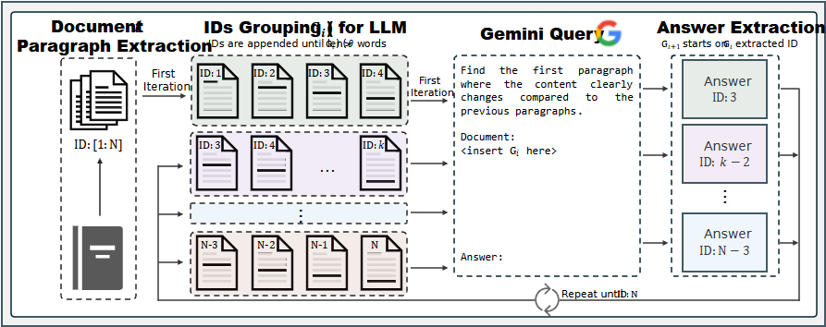
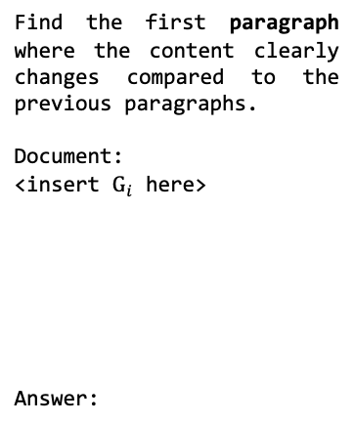
LumberChunker
Uses LLM to determine the most optimal points for segmentation
Notes:
So now let me introduce our method: LumberChunker. The key idea here is that it we use an LLM to determine the most optimal segmentation points within a document.

Slide 23
LumberChunker
We segment document paragraph-wise and assign an ID to each one
Notes:
So now let me introduce our method: LumberChunker. The key idea here is that it we use an LLM to determine the most optimal segmentation points within a document.

Slide 24
LumberChunker
Notes:
So now let me introduce our method: LumberChunker. The key idea here is that it we use an LLM to determine the most optimal segmentation points within a document.

Slide 25
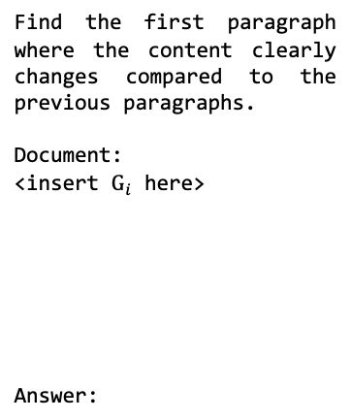
LumberChunker
Notes:
So now let me introduce our method: LumberChunker. The key idea here is that it we use an LLM to determine the most optimal segmentation points within a document.

Slide 26
LumberChunker
Textual structure is preserved ✓
Notes:
We ensure that the segments will be well-structured and that the integrity of the document is preserved.

Slide 27
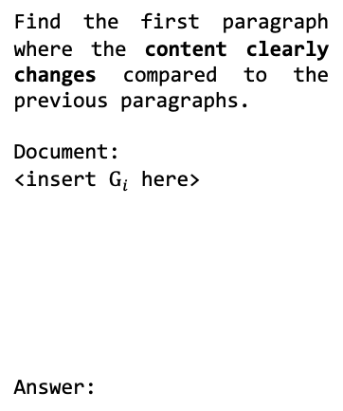
LumberChunker
Chunks will be semantically coherent ✓
Notes:
And by leveraging the model’s understanding, each chunk will also remain semantically coherent, improving the overall retrieval quality.

Slide 28
LumberChunker
Gemini points the ID where a significant content shift starts
Notes:
So now let me introduce our method: LumberChunker. The key idea here is that it we use an LLM to determine the most optimal segmentation points within a document.

Slide 29
LumberChunker
Notes:
So now let me introduce our method: LumberChunker. The key idea here is that it we use an LLM to determine the most optimal segmentation points within a document.

Slide 30
LumberChunker
Cycle repeats until entire document is segmented
Notes:
So now let me introduce our method: LumberChunker. The key idea here is that it we use an LLM to determine the most optimal segmentation points within a document.

Slide 31
GutenQA
100 public domain narrative books from Project Gutenberg.
Notes:
We also introduce GutenQA, a new dataset built from 100 public domain books sourced from Project Gutenberg.
Why not just use popular datasets that already collected information from project Gutenberg?

Slide 32
GutenQA
100 public domain narrative books from Project Gutenberg.
Manually extracted paragraph-wise.
Notes:
We also introduce GutenQA, a new dataset built from 100 public domain books sourced from Project Gutenberg.
Why not just use popular datasets that already collected information from project Gutenberg?

Slide 33
GutenQA
100 public domain narrative books from Project Gutenberg.
Manually extracted paragraph-wise.
Why not use large-scale datasets using Project Gutenberg data?
Ex: Deepmind NarrativeQA
Notes:
We also introduce GutenQA, a new dataset built from 100 public domain books sourced from Project Gutenberg.
Why not just use popular datasets that already collected information from project Gutenberg?

Slide 34
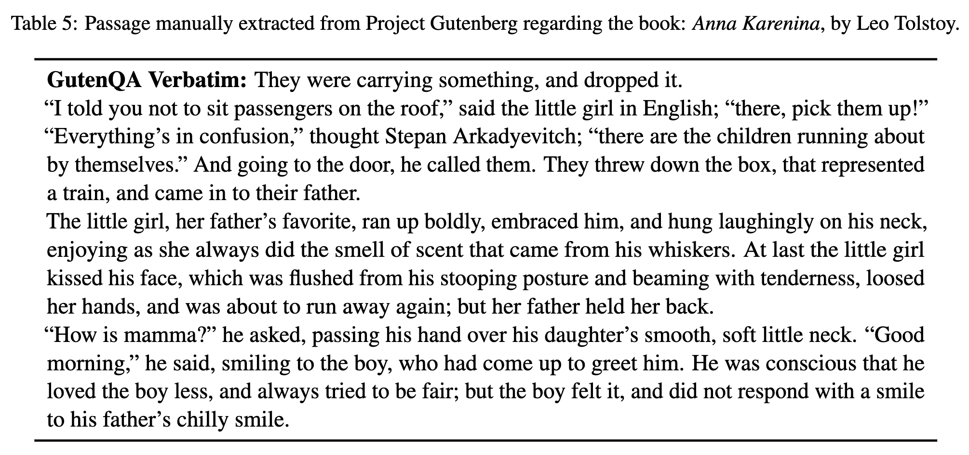
GutenQA
100 public domain narrative books from Project Gutenberg.
Manually extracted paragraph-wise.
Why not use large-scale datasets using Project Gutenberg data?
Ex: Deepmind NarrativeQA
Notes:
We also introduce GutenQA, a new dataset built from 100 public domain books sourced from Project Gutenberg.
Why not just use popular datasets that already collected information from project Gutenberg?

Slide 35
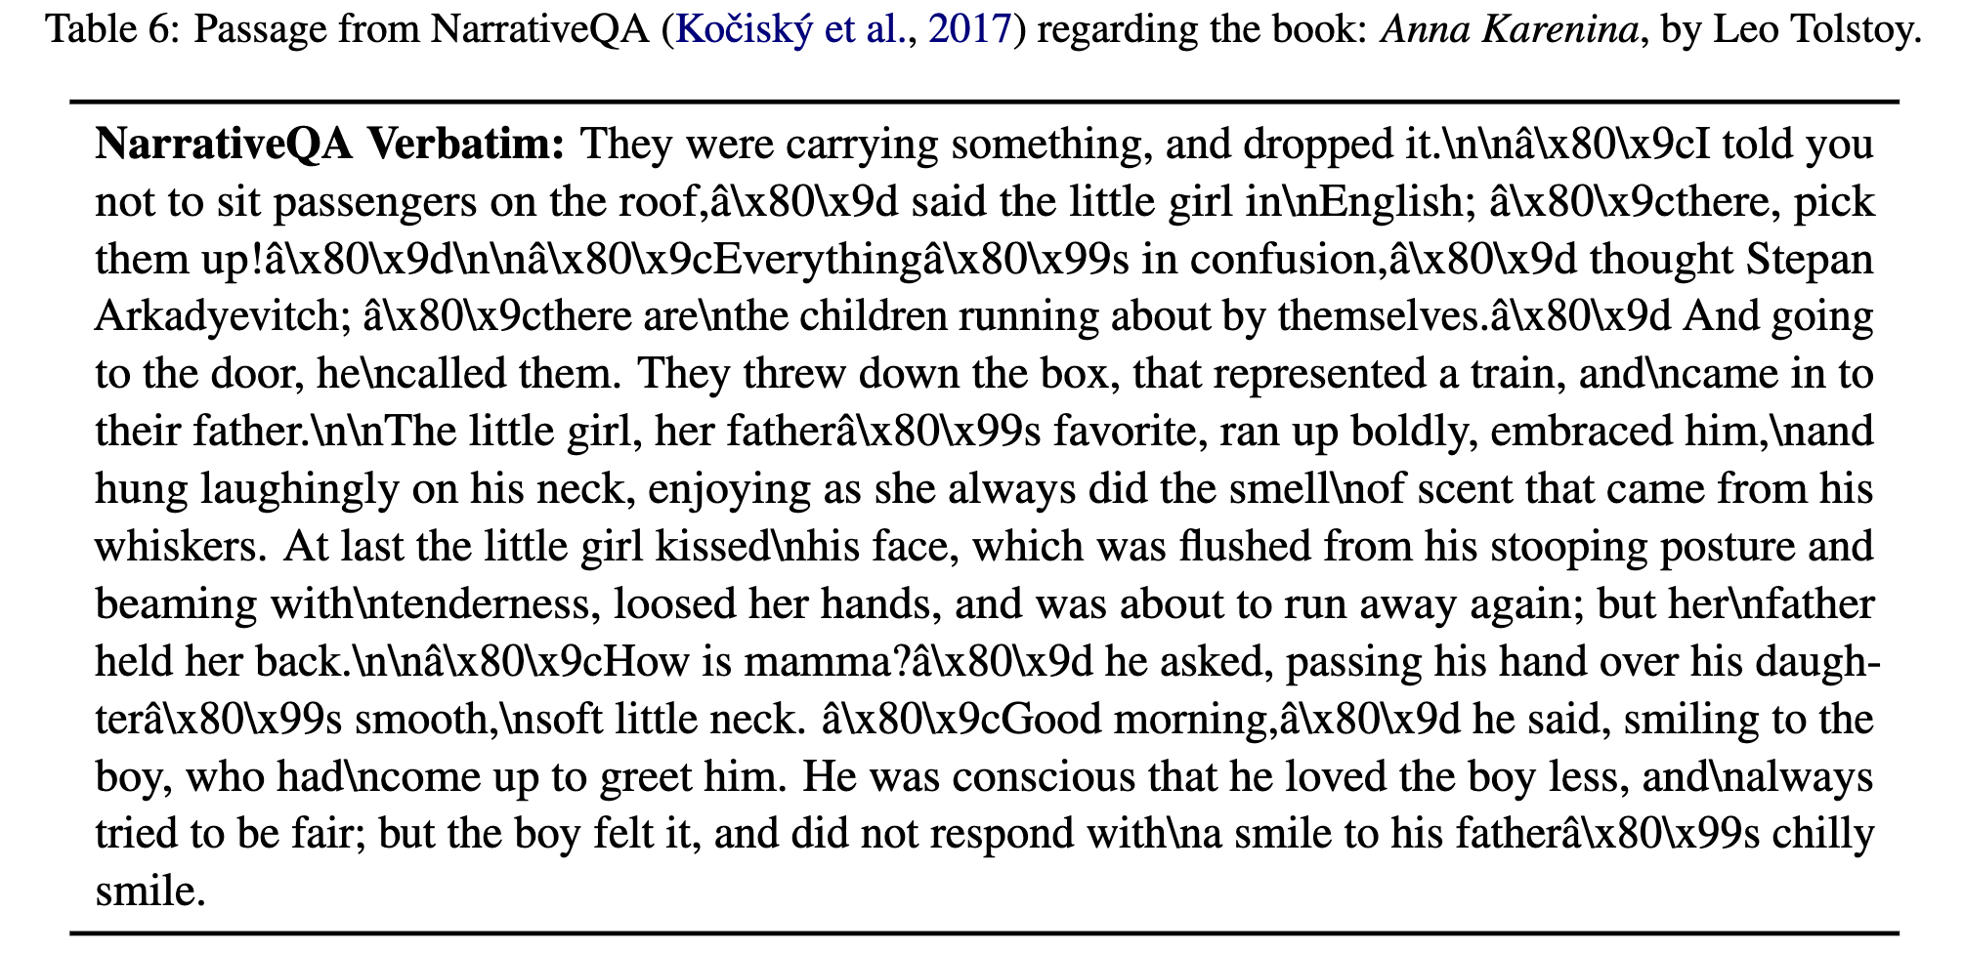
GutenQA
100 public domain narrative books from Project Gutenberg.
Manually extracted paragraph-wise.
Why not use large-scale datasets using Project Gutenberg data?
Ex: Deepmind NarrativeQA
Notes:
We also introduce GutenQA, a new dataset built from 100 public domain books sourced from Project Gutenberg.
Why not just use popular datasets that already collected information from project Gutenberg?

Slide 36
GutenQA
100 public domain narrative books from Project Gutenberg.
Manually extracted paragraph-wise.
Why not use large-scale datasets using Project Gutenberg data?
Non-standard characters: ‘â’ and ‘\x80\x9c’
Likely result from encoding issues on extraction process
Misplaced ‘\n’ characters
Notes:
And even if the weird characters are not a problem for language models, our text ends up being more readable and free from such errors.
Why not just use popular datasets that already collected information from project Gutenberg?

Slide 37
GutenQA
GPT-3.5-turbo-0125 generates 100 questions for each book.
Spanning different parts of the book.
Questions designed to be factual and specific, targeting unique information.
Notes:
And even if the weird characters are not a problem for language models, our text ends up being more readable and free from such errors.
It contains 3,000 QA pairs which are manually filtered from an initial set of 10,000 automatically generated ones.

Slide 38
GutenQA
GPT-3.5-turbo-0125 generates 100 questions for each book.
Spanning different parts of the book.
Questions designed to be factual and specific, targeting unique information.
If question is generic, multiple passages may answer it.
Q: How much yearly income does Mr. Bennet's estate provide for his family?
A: Mr. Bennet's estate provides an income of two thousand a year.
Pride and Prejudice
Notes:
And even if the weird characters are not a problem for language models, our text ends up being more readable and free from such errors.
It contains 3,000 QA pairs which are manually filtered from an initial set of 10,000 automatically generated ones.

Slide 39
GutenQA
GPT-3.5-turbo-0125 generates 100 questions for each book.
Spanning different parts of the book.
Questions designed to be factual and specific, targeting unique information.
If question is generic, multiple passages may answer it.
GPT questions require filtering.
3000 Question-Answer pairs (30 for each book).
Q: How much yearly income does Mr. Bennet's estate provide for his family?
A: Mr. Bennet's estate provides an income of two thousand a year.
Pride and Prejudice
Notes:
And even if the weird characters are not a problem for language models, our text ends up being more readable and free from such errors.
It contains 3,000 QA pairs which are manually filtered from an initial set of 10,000 automatically generated ones.

Slide 40
GutenQA
Dataset organized into the following columns:
Book Name: The title of the book from which the passage is extracted.
...
Question: A question regarding the specific chunk of text. Not all chunks have a question, as only 30 are generated per book.
Answer: Then answer corresponding to the question.
Chunk Must Contain: A specific substring from the book indicating where the answer is present. This ensures that, despite the chunking methodology, the correct chunk includes this particular string.
Notes:
And even if the weird characters are not a problem for language models, our text ends up being more readable and free from such errors.
It contains 3,000 QA pairs which are manually filtered from an initial set of 10,000 automatically generated ones.

Slide 41
GutenQA
Dataset organized into the following columns:
Book Name: The title of the book from which the passage is extracted.
...
Question: A question regarding the specific chunk of text. Not all chunks have a question, as only 30 are generated per book.
Answer: Then answer corresponding to the question.
Chunk Must Contain: A specific substring from the book indicating where the answer is present. This ensures that, despite the chunking methodology, the correct chunk includes this particular string.
Notes:
And even if the weird characters are not a problem for language models, our text ends up being more readable and free from such errors.
It contains 3,000 QA pairs which are manually filtered from an initial set of 10,000 automatically generated ones.

Slide 42
GutenQA
Dataset organized into the following columns:
Book Name: The title of the book from which the passage is extracted.
...
Question: A question regarding the specific chunk of text. Not all chunks have a question, as only 30 are generated per book.
Answer: Then answer corresponding to the question.
Chunk Must Contain: A specific substring from the book indicating where the answer is present. This ensures that, despite the chunking methodology, the correct chunk includes this particular string.
Easier retrieval evaluation.
Q: How much yearly income does Mr. Bennet's estate provide for his family?
A: Mr. Bennet's estate provides an income of two thousand a year.
CMC: “Mr. Bennet’s property consisted almost entirely in an estate of two thousand a year”
Pride and Prejudice
Notes:
We don’t need to know for each method beforehand what is the chunk with the correct answer.
We just need to perform substring matching on the chunks and check for matching.

Slide 43

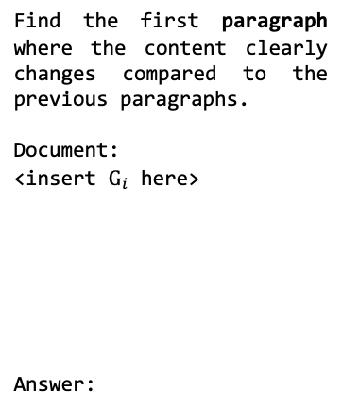
Number of words in prompt is relevant
Notes:
Intuitively, one might hypothesize that increasing the prompt length reduces retrieval difficulty
Because larger chunks reduce the overall search space, thereby increasing the likelihood of retrieving the correct chunk.
To test this hypothesis, we analyze how LumberChunker’s DCG scores were influenced by different prompt lenghts

Slide 44
Number of words in prompt is relevant
Longer chunks don’t correlate with better performance.
Maybe model can’t focus on relevant parts of the input?

Slide 45

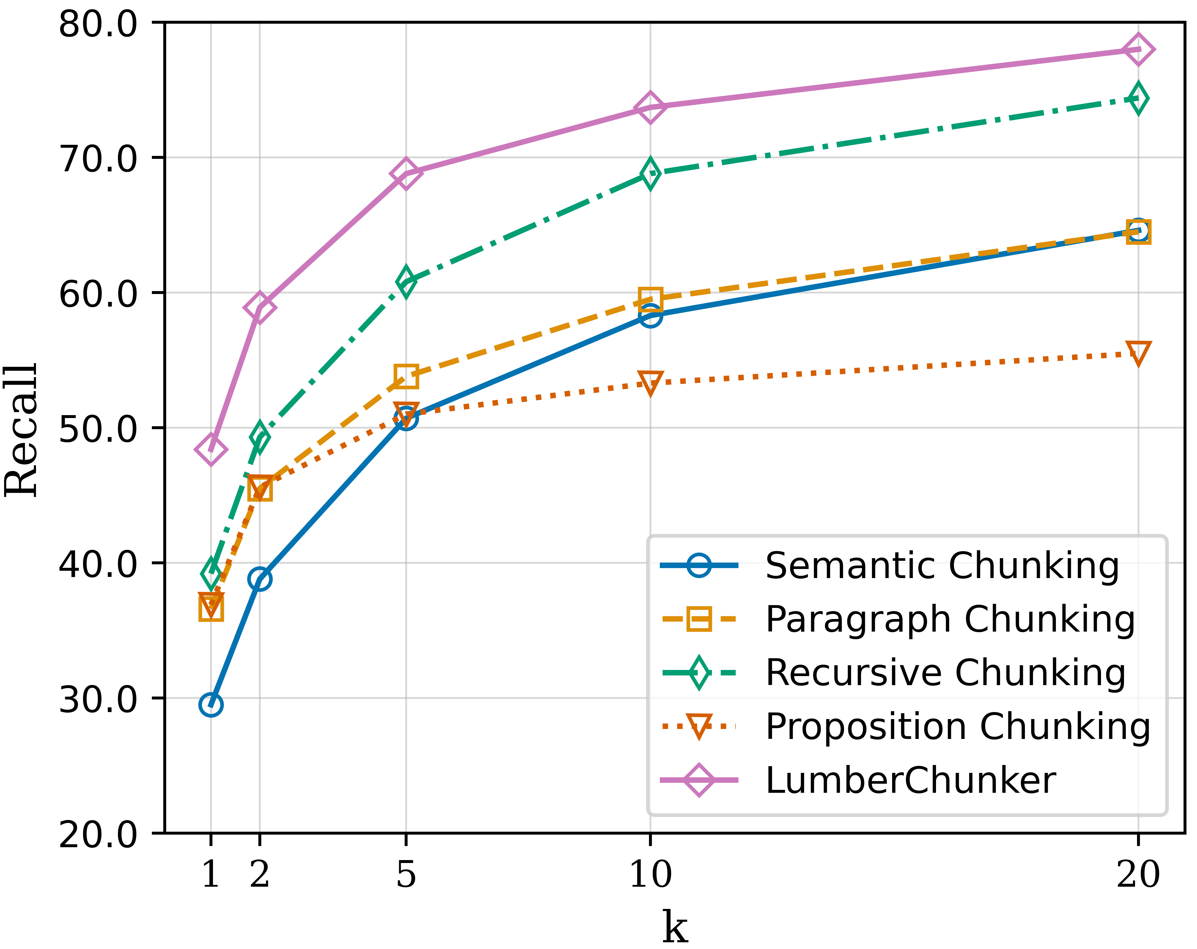
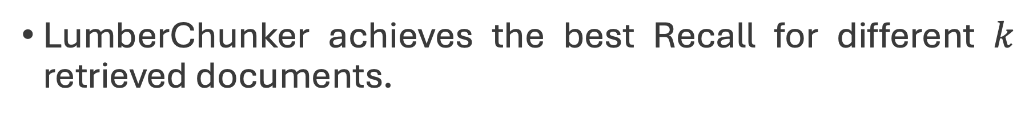
Our Chunks improve retrieval
Notes:
We achieve the best recall across multiple baselines for different values of k retrieved documents.

Slide 46
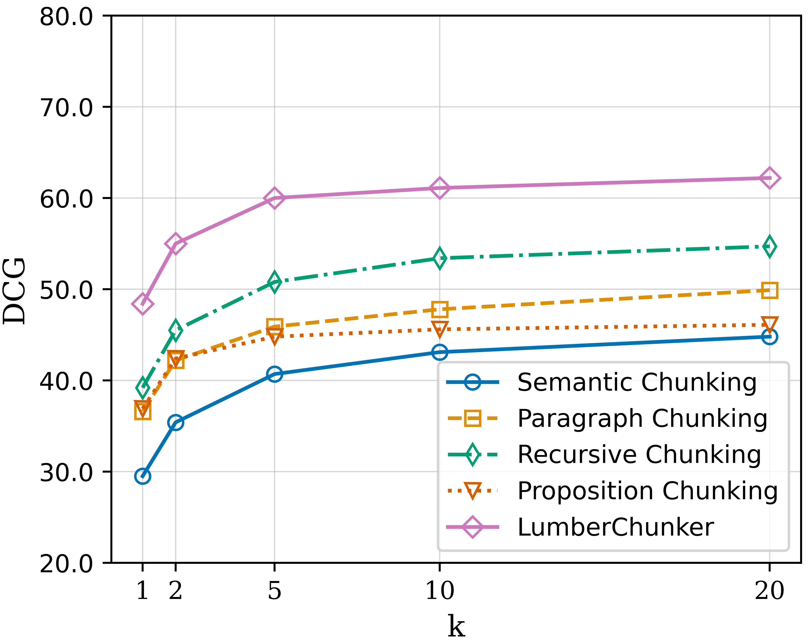
Our Chunks improve retrieval
Our chunks are consistently ranked higher within the retrieved results.
Notes:
Moreover, when we analyze the results from a DCG perspective, we see that our chunks are consistently ranked higher within the retrieved results. This strongly suggests that our segmentation method is quite effective.

Slide 47


88.89
90.53
84.96
Accuracy (%)
37.76
26.43
Recursive Chunking is beaten once again by our method.
Better retrieval corresponds to enhanced performance on a QA task.
Notes:
What about the effect of LumberChunker on a QA task? Do its chunks enhance the generation quality?
Once again, the answer is yes!
First, we see that LumberChunker outperforms again Recursive Chunking, which confirms that better retrieval directly translates into improved performance on a QA task.

Slide 48

We almost match Manual Segmentation
88.89
90.53
84.96
Accuracy (%)
37.76
26.43
LumberChunker almost matches RAG with manual chunking (gold standard for text segmentation).
However, LumberChunker does not require human intervention.
Notes:
On a second note, when we compare LumberChunker to the gold standard approach, which would be doing RAG with manual made chunks, we see that our method comes very close in terms of accuracy.
But what’s even more important is that LumberChunker achieves this without any human intervention in the segmentation process, which significantly reduces the time required to perform the task.

Slide 49
RAG > Long Context LLMs
88.89
90.53
84.96
Accuracy (%)
37.76
26.43
Gemini-1.5M Pro achieves modest accuracy.
Long context models may not be that good processing large inputs.
Doing RAG seems to still be the better approach for a QA task.
Notes:
Interestingly, something that came up as a surprise is that the Open-Book method, despite being designed for large inputs, only achieves an accuracy of 37.76%. This suggests that models with long context capabilities may not be that good yet processing large inputs.
We see that all RAG methods outperform Open-Book, which highlights the current advantage of RAG approaches for QA tasks.

Slide 50
Efficiency is a trade-off in our method
Non-LLM approaches like Recursive Chunking are very fast.
Propositions come up as most inefficient method.
They can be performed as an offline batch job
Notes:
However, it is possible to run offline requests unlike LumberChunker.

Slide 51

Cost is minimal for smaller documents
Current trend is for LLM prices decreasing.
LumberChunker will benefit from this in future.
Notes:
However, it is possible to run offline requests unlike LumberChunker.

Slide 52
Conclusions
LumberChunker does enhances retrieval performance when working with narrative type of texts.
GutenQA can be used to evaluate not only text segmentation approaches as also Retrieval and QA models.
LumberChunker showcases the impact of proper text segmentation for enhancing QA systems.
Notes:
In conclusion, LumberChunker does seem to enhance retrieval performance, particularly when dealing with narrative texts.
We would like to highlight that GutenQA is a versatile dataset, as it can be used not just to evaluate text segmentation approaches, but also for assessing retrieval and QA models.
Finally, we hope to have demonstrates the significant impact that proper text segmentation can have on the effectiveness of QA systems, highlighting how critical this process is for enhancing overall performance.

Slide 53


LumberChunker
arXiv: https://arxiv.org/abs/2406.17526
GitHub: https://github.com/joaodsmarques/LumberChunker
Email: andre.v.duarte@tecnico.ulisboa.pt
HuggingFace: https://huggingface.co/datasets/LumberChunker/GutenQA
Notes:
Thank you for your attention!
If you have any questions, feel free to reach out!

Slide 54
Chunk this example!
Cluster semantically similar segments?
ID1: “What about a story?” I said.
ID2: “Could you very sweetly tell Winnie-the-Pooh one?”
ID3: “I suppose I could,” I said. “What sort of stories does he like?”
ID4: “About himself. Because he’s that sort of Bear.”
ID5: “Oh, I see.”
ID6: “So could you very sweetly?”
ID7: “I’ll try,” I said.
ID8: So I tried.
ID9: Once upon a time, a very long time ago now, about last Friday, Winnie-the-Pooh lived in a forest all by himself under the name of Sanders.
ID10: “What does ‘under the name’ mean?” asked Christopher Robin.
...
Winnie-the-Pooh
?
Cosine-Similarity > 0.8
Notes:
Like this? Chunking every 4 paragraphs?

Slide 55
Chunk this example!
Cluster semantically similar segments?
ID1: “What about a story?” I said.
ID2: “Could you very sweetly tell Winnie-the-Pooh one?”
ID3: “I suppose I could,” I said. “What sort of stories does he like?”
ID4: “About himself. Because he’s that sort of Bear.”
ID5: “Oh, I see.”
ID6: “So could you very sweetly?”
ID7: “I’ll try,” I said.
ID8: So I tried.
ID9: Once upon a time, a very long time ago now, about last Friday, Winnie-the-Pooh lived in a forest all by himself under the name of Sanders.
ID10: “What does ‘under the name’ mean?” asked Christopher Robin.
...
Winnie-the-Pooh
✓
Notes:
Like this? Chunking every 4 paragraphs?

Slide 56
Chunk this example!
Cluster semantically similar segments?
ID1: “What about a story?” I said.
ID2: “Could you very sweetly tell Winnie-the-Pooh one?”
ID3: “I suppose I could,” I said. “What sort of stories does he like?”
ID4: “About himself. Because he’s that sort of Bear.”
ID5: “Oh, I see.”
ID6: “So could you very sweetly?”
ID7: “I’ll try,” I said.
ID8: So I tried.
ID9: Once upon a time, a very long time ago now, about last Friday, Winnie-the-Pooh lived in a forest all by himself under the name of Sanders.
ID10: “What does ‘under the name’ mean?” asked Christopher Robin.
...
Winnie-the-Pooh
?
Cosine-Similarity > 0.8
Notes:
Like this? Chunking every 4 paragraphs?

Slide 57
Chunk this example!
Cluster semantically similar segments?
ID1: “What about a story?” I said.
ID2: “Could you very sweetly tell Winnie-the-Pooh one?”
ID3: “I suppose I could,” I said. “What sort of stories does he like?”
ID4: “About himself. Because he’s that sort of Bear.”
ID5: “Oh, I see.”
ID6: “So could you very sweetly?”
ID7: “I’ll try,” I said.
ID8: So I tried.
ID9: Once upon a time, a very long time ago now, about last Friday, Winnie-the-Pooh lived in a forest all by himself under the name of Sanders.
ID10: “What does ‘under the name’ mean?” asked Christopher Robin.
...
Winnie-the-Pooh
✘
Notes:
Like this? Chunking every 4 paragraphs?

Slide 58
Chunk this example!
Cluster semantically similar segments?
ID1: “What about a story?” I said.
ID2: “Could you very sweetly tell Winnie-the-Pooh one?”
ID3: “I suppose I could,” I said. “What sort of stories does he like?”
ID4: “About himself. Because he’s that sort of Bear.”
ID5: “Oh, I see.”
ID6: “So could you very sweetly?”
ID7: “I’ll try,” I said.
ID8: So I tried.
ID9: Once upon a time, a very long time ago now, about last Friday, Winnie-the-Pooh lived in a forest all by himself under the name of Sanders.
ID10: “What does ‘under the name’ mean?” asked Christopher Robin.
...
Winnie-the-Pooh
Notes:
Like this? Chunking every 4 paragraphs?

Slide 59
Chunk this example!
Cluster semantically similar segments?
ID1: “What about a story?” I said.
ID2: “Could you very sweetly tell Winnie-the-Pooh one?”
ID3: “I suppose I could,” I said. “What sort of stories does he like?”
ID4: “About himself. Because he’s that sort of Bear.”
ID5: “Oh, I see.”
ID6: “So could you very sweetly?”
ID7: “I’ll try,” I said.
ID8: So I tried.
ID9: Once upon a time, a very long time ago now, about last Friday, Winnie-the-Pooh lived in a forest all by himself under the name of Sanders.
ID10: “What does ‘under the name’ mean?” asked Christopher Robin.
...
Winnie-the-Pooh
Notes:
Like this? Chunking every 4 paragraphs?

Slide 60
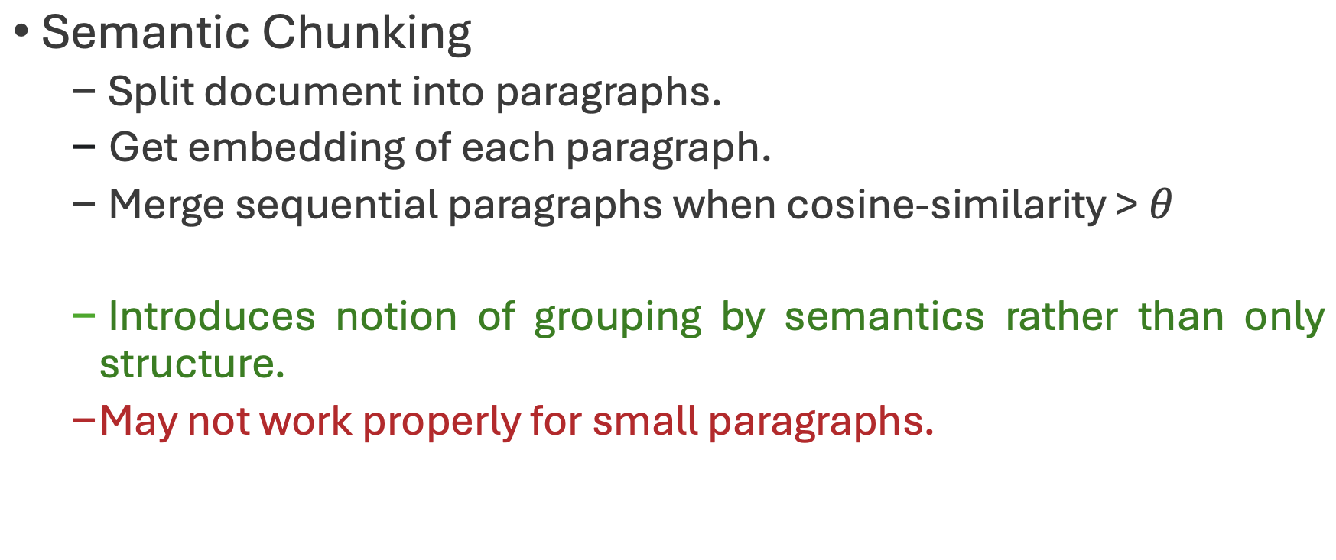
Chunk this example!
Cluster semantically similar segments?
Notes:
Probably not!! right?? We can clearly see that most of the paragraphs are related and therefore, they should be grouped together.
This is the problem with classical approaches: they give such emphasis on keeping a good document structure that chunks can end up being quite random in terms of their content.

Slide 61
Chunk this example!
Cluster semantically similar segments?
ID1: “What about a story?” I said.
ID2: “Could you very sweetly tell Winnie-the-Pooh one?”
ID3: “I suppose I could,” I said. “What sort of stories does he like?”
ID4: “About himself. Because he’s that sort of Bear.”
ID5: “Oh, I see.”
ID6: “So could you very sweetly?”
ID7: “I’ll try,” I said.
ID8: So I tried.
ID9: Once upon a time, a very long time ago now, about last Friday, Winnie-the-Pooh lived in a forest all by himself under the name of Sanders.
ID10: “What does ‘under the name’ mean?” asked Christopher Robin.
Winnie-the-Pooh
Notes:
Like this? Chunking every 4 paragraphs?

Slide 62
Create Propositions?
Propositions
Transforms document into a new corpus.
Paragraphs are converted into small sentences.
Each conveying individual and concrete fact.
Very efficient for fact-based text (ex: Wikipedia)
May not work properly for small paragraphs.

Slide 63
Create Propositions?
ID1: Christopher Robin suggested telling Winnie-the-Pooh a story.
ID2: I agreed to tell Winnie-the-Pooh a story
ID3: I asked what kind of stories Winnie-the-Pooh likes.
ID4: Christopher Robin said Winnie-the-Pooh likes stories about himself.
ID5: I understood that Winnie-the-Pooh is that sort of Bear.
ID6: I agreed to try telling Winnie-the-Pooh a story.
ID7: Once upon a time, Winnie-the-Pooh lived in a forest all by himself.
ID8: It was a very long time ago now.
ID9: It was about last Friday when Winnie-the-Pooh lived in the forest all by himself.
ID10: Winnie-the-Pooh lived under the name of Sanders.
ID10: Christopher Robin asked, “What does ’under the name’ mean?”
Winnie-the-Pooh
Notes:
Like this? Chunking every 4 paragraphs?

